Slide 1
Industrial Economics PPT - 7
Long Run Analysis of Cost and Output,
Economies of Scale, Diseconomies of Scale,
Economies & Diseconomies of Scope

Slide 2
Cost in the Long Run
In the long run, a firm has much more flexibility.
It can expand its capacity by expanding existing factories or building new ones; it can expand or contract its labor force, and in some cases, it can change the design of its products or introduce new products.
In this section, we show how a firm can choose its combination of inputs to minimize its cost of producing a given output.
We will also examine the relationship between long-run cost and the level of output.
We begin by taking a careful look at the cost of using capital equipment.
We then show how this cost, along with the cost of labor, enters into the production decision.

Slide 3
The User Cost of Capital
Firms often rent or lease equipment, buildings, and other capital used in the production process. On other occasions, the capital is purchased.
In our analysis, however, it will be useful to treat capital as though it were rented even if it was purchased.
An illustration will help to explain how and why we do this.
Let’s suppose that Air India is thinking about purchasing a new Boeing 777 airplane for $150 million. Even though Air India would pay a large sum for the airplane now, for economic purposes the purchase price can be allocated or amortized across the life of the airplane. This will allow Air India to compare its revenues and costs on an annual flow basis.
We will assume that the life of the airplane is 30 years; the amortized cost is therefore $5 million per year. The $5 million can be viewed as the annual economic depreciation for the airplane.

Slide 4
So far, we have ignored the fact that had the firm not purchased the airplane, it could have earned interest on its $150 million. This forgone interest is an opportunity cost that must be accounted for.
Therefore, the user cost of capital— the annual cost of owning and using the airplane instead of selling it or never buying it in the first place—is given by the sum of the economic depreciation and the interest (i.e., the financial return) that could have been earned had the money been invested elsewhere.
Formally,
User Cost of Capital = Economic Depreciation + (Interest Rate)*(Value of Capital)

Slide 5
COST IN THE LONG RUN
The User Cost of Capital
user cost of capital Annual cost of owning and using a capital asset, equal to economic depreciation plus forgone interest.
The user cost of capital is given by the sum of the economic depreciation and the interest (i.e., the financial return) that could have been earned had the money been invested elsewhere.
Formally,
We can also express the user cost of capital as a rate per dollar of capital:

Slide 6
The Cost-Minimizing Input Choice
As we’ve already pointed out, in the long run the firm can change all of its inputs.
We will now show how the firm chooses the combination of inputs that minimizes the cost of producing a certain output, given information about wages and the user cost of capital.
We will then examine the relationship between long-run cost and the level of output.
We now turn to a fundamental problem that all firms face: how to select inputs to produce a given output at minimum cost.
For simplicity, we will work with two variable inputs: labor (measured in hours of work per year) and capital (measured in hours of use of machinery per year).
The amount of labor and capital that the firm uses will depend, of course, on the prices of these inputs.
In this case, the price of labor is simply the wage rate, w.
But what about the price of capital?

Slide 7
The Price Of Capital
In the long run, the firm can adjust the amount of capital it uses.
Unlike labor expenditures, however, large initial expenditures on capital are necessary.
In order to compare the firm’s expenditure on capital with its ongoing cost of labor, we want to express this capital expenditure as a flow—e.g., in dollars per year.
To do this, we must amortize the expenditure by spreading it over the lifetime of the capital, and we must also account for the forgone interest that the firm could have earned by investing the money elsewhere.
As we have just seen, this is exactly what we do when we calculate the user cost of capital.
As above, the price of capital is its user cost, given by
r = Depreciation rate + Interest rate.
The Rental Rate Of Capital - As we noted, capital is often rented rather than purchased. An example is office space in a large office building. In this case, the price of capital is its rental rate—i.e., the cost per year for renting a unit of capital.
If the capital market is competitive, the rental rate should be equal to the user cost, r.
Capital that is purchased can be treated as though it were rented at a rental rate equal to the user cost of capital.
For the remainder of this chapter, we will therefore assume that a firm rents all of its capital at a rental rate, or “price,” r, just as it hires labor at a wage rate, or “price,” w.

Slide 8

The Isocost Line
Isocost Line - Graph showing all possible combinations of labor and capital that can be purchased by a firm for a given total cost.
To see what an isocost line looks like, recall that the total cost C of producing any particular output is given by the sum of the firm’s labor cost wL and its capital cost rK:
If we rewrite the total cost equation as an equation for a straight line, we get
It follows that the isocost line has a slope of ΔK/ΔL = −(w/r), which is the ratio of the wage rate to the rental cost of capital.
It tells us that if the firm gave up a unit of labor (and recovered w dollars in cost) to buy w/r units of capital at a cost of r dollars per unit, its total cost of production would remain the same.

Slide 9
Choosing Inputs
Suppose we wish to produce at an output level q1 . How can we do so at minimum cost? Look at the firm’s production isoquant, labeled q1 , in Figure 7.3. The problem is to choose the point on this isoquant that minimizes total cost.
Figure 7.3 illustrates the solution to this problem. Suppose the firm were to spend C0 on inputs. Unfortunately, no combination of inputs can be purchased for expenditure C0 that will allow the firm to achieve output q1.
However, output q1 can be achieved with the expenditure of C2, either by using K2 units of capital and L2 units of labor, or by using K3 units of capital and L3 units of labor. But C2 is not the minimum cost.
The same output q1 can be produced more cheaply, at a cost of C1, by using K1 units of capital and L1 units of labor. In fact, isocost line C1 is the lowest isocost line that allows output q1 to be produced.
In fact, isocost line C1 is the lowest isocost line that allows output q1 to be produced. The point of tangency of the isoquant q1 and the isocost line C1 at point A gives us the cost-minimizing choice of inputs, L1 and K1 , which can be read directly from the diagram. At this point, the slopes of the isoquant and the isocost line are just equal.

Slide 10
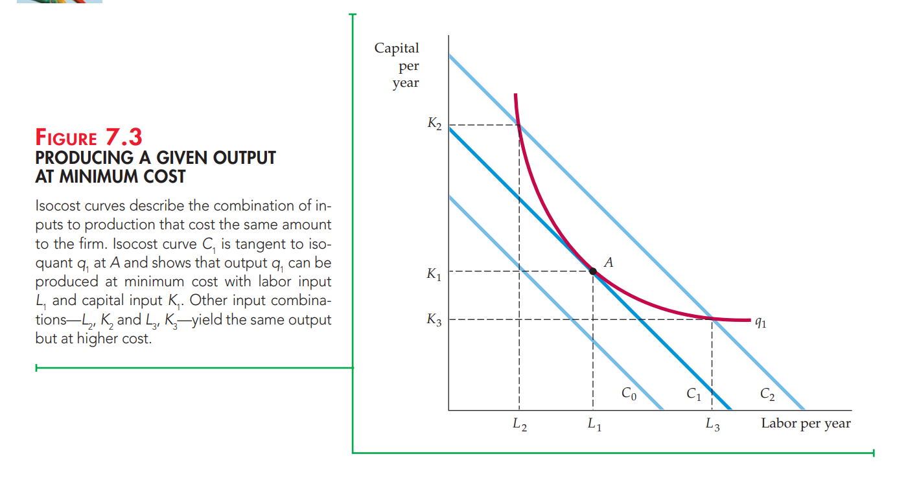

Slide 11
Firms Maximize Profit.
What does it mean?
That firms minimise cost given production OR
That firms maximise revenue given costs
The conditions are exactly the same!

Slide 12
Suppose that the price of one of the inputs, such as labor, were to increase. In that case, the slope of the isocost line −(w/r) would increase in magnitude and the isocost line would become steeper. Figure 7.4 shows this.
Initially, the isocost line is C1 , and the firm minimizes its costs of producing output q1 at A by using L1 units of labor and K1 units of capital.
When the price of labor increases, the isocost line becomes steeper. The isocost line C2 reflects the higher price of labor.
Facing this higher price of labor, the firm minimizes its cost of producing output q1 by producing at B, using L2 units of labor and K2 units of capital.
The firm has responded to the higher price of labor by substituting capital for labor in the production process.
How does the isocost line relate to the firm’s production process?

Slide 13


Recall that in our analysis of production technology, we showed that the marginal rate of technical substitution of labor for capital (MRTS) is the negative of the slope of the isoquant and is equal to the ratio of the marginal products of labor and capital:
(7.3)
Above, we noted that the isocost line has a slope of K/L = -w/r.
It follows that when a firm minimizes the cost of producing a particular output, the following condition holds:
We can rewrite this condition slightly as follows:
(7.4)

Slide 14
MPL /w is the additional output that results from spending an additional dollar for labor.
Suppose that the wage rate is $10 and that adding a worker to the production process will increase output by 20 units. The additional output per dollar spent on an additional worker will be 20/10 = 2 units of output per dollar.
Similarly, MPK/r is the additional output that results from spending an additional dollar for capital.
Therefore, equation (7.4) tells us that a cost-minimizing firm should choose its quantities of inputs so that the last dollar’s worth of any input added to the production process yields the same amount of extra output.
For a firm, this condition must hold for cost minimization. At that point, the firm is minimizing its cost.

Slide 15
Firm’s Expansion Path in the Long Run
The curve passing through the points of tangency between the firm’s isocost lines and its isoquants is its expansion path.
The expansion path describes the combinations of labor and capital that the firm will choose to minimize costs at each output level.
As long as the use of both labor and capital increases with output, the curve will be upward sloping.
The cost-minimization exercise yields the result illustrated by Figure 7.6. We have assumed that the firm can hire labor L at w = $10/hour and rent a unit of capital K for r = $20/hour. Given these input costs, we have drawn three of the firm’s isocost lines. Each isocost line is given by the following equation: C = ($10/hour)*(L) + ($20/hour)*(K)

Slide 16
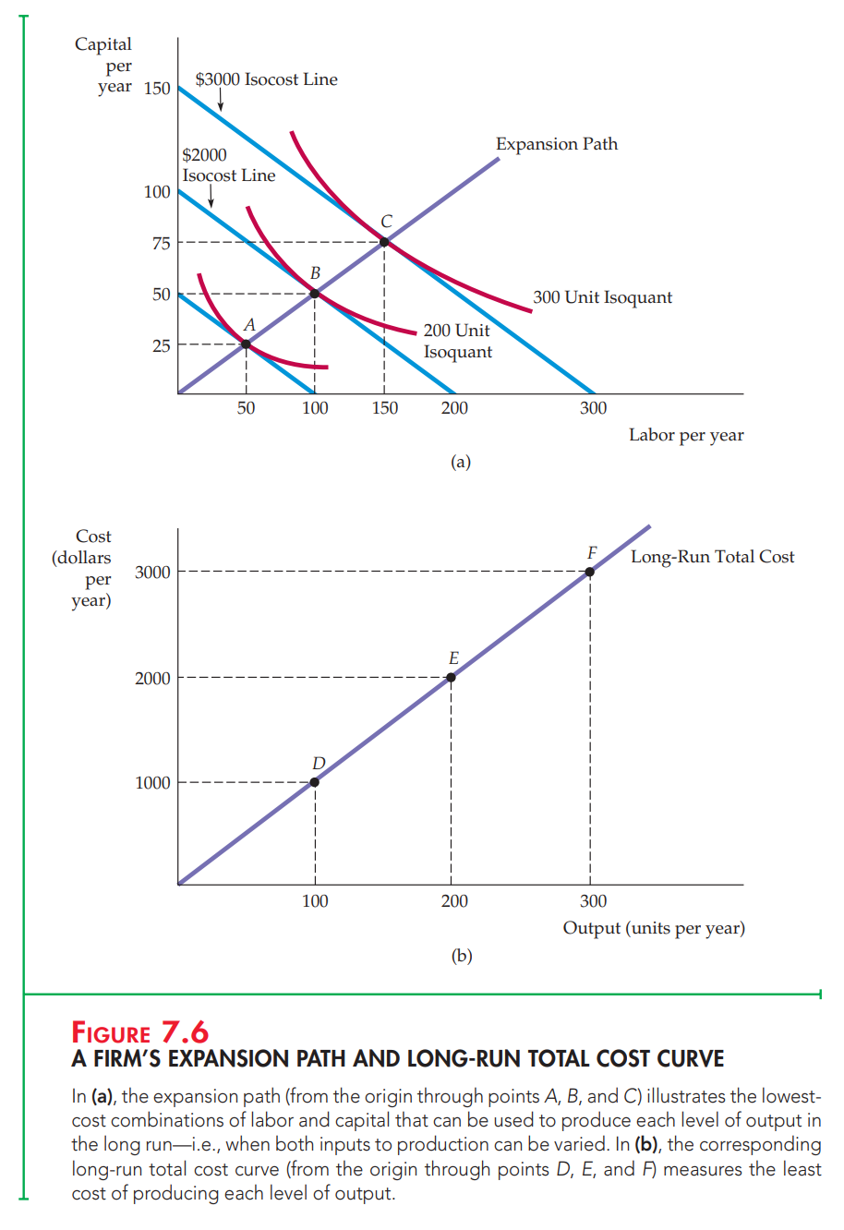

Slide 17
In Figure 7.6 (a), the lowest (unlabeled) line represents a cost of $1000, the middle line $2000, and the highest line $3000.
You can see that each of the points A, B, and C in Figure 7.6 (a) is a point of tangency between an isocost curve and an isoquant. Point B, for example, shows us that the lowest-cost way to produce 200 units of output is to use 100 units of labor and 50 units of capital; this combination lies on the $2000 isocost line. Similarly, the lowest-cost way to produce 100 units of output (the lowest unlabeled isoquant) is $1000 (at point A, L = 50, K = 25); the least-cost means of getting 300 units of output is $3000 (at point C, L = 150, K = 75).
The curve passing through the points of tangency between the firm’s isocost lines and its isoquants is its expansion path.

Slide 18
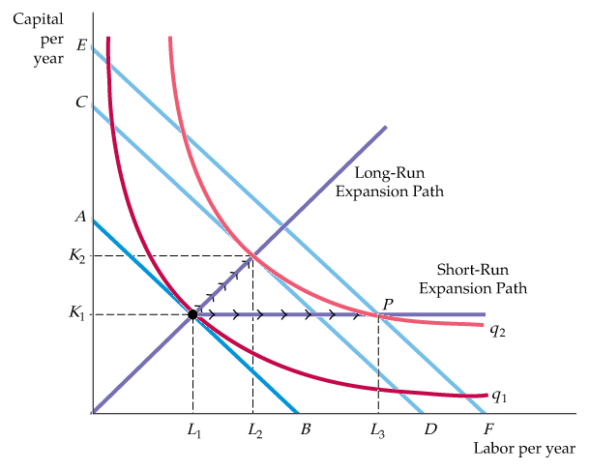
LONG-RUN VERSUS SHORT-RUN COST CURVES
The Inflexibility of Short-Run Production
Figure 7.7
The Inflexibility of Short-Run Production
When a firm operates in the short run, its cost of production may not be minimized because of inflexibility in the use of capital inputs.
Output is initially at level q₁.
In the short run, output q₂ can be produced only by increasing labor from L₁ to L₃ because capital is fixed at K₁.
In the long run, the same output can be produced more cheaply by increasing labor from L₁ to L₂ and capital from K₁ to K₂.

Slide 19
Recall that we defined the long run as occurring when all inputs to the firm are variable.
In the long run, the firm’s planning horizon is long enough to allow for a change in plant size. This added flexibility allows the firm to produce at a lower average cost than in the short run.
To see why, we might compare the situation in which capital and labor are both flexible to the case in which capital is fixed in the short run.
Figure 7.7 shows the firm’s production isoquants. The firm’s long-run expansion path is the straight line from the origin.
Now, suppose capital is fixed at a level K1 in the short run. To produce output q1 , the firm would minimize costs by choosing labor equal to L1 , corresponding to the point of tangency with the isocost line AB.
The inflexibility appears when the firm decides to increase its output to q2 without increasing its use of capital. If capital were not fixed, it would produce this output with capital K2 and labor L2 . Its cost of production would be reflected by isocost line CD.
However, the fact that capital is fixed, forces the firm to increase its output by using capital K1 and labor L3 at point P. Point P lies on the isocost line EF, which represents a higher cost than isocost line CD.
Why is the cost of production higher when capital is fixed? Because the firm is unable to substitute relatively inexpensive capital for more costly labor when it expands production. This inflexibility is reflected in the short-run expansion path, which begins as a line from the origin and then becomes a horizontal line when the capital input reaches K1 .

Slide 20
Long-Run Average and Marginal Cost
In the long run, the ability to change the amount of capital allows the firm to reduce costs. To see how costs vary as the firm moves along its expansion path in the long run, we can look at the long-run average and marginal cost curves.
Consider that when output is increased continuously, a firm’s production technology exhibits first increasing returns to scale, then constant returns to scale, and eventually decreasing returns to scale. Figure 7.9 shows a typical long-run average cost curve (LAC) consistent with this description of the production process.
Like the short-run average cost curve (SAC), the long-run average cost curve is U-shaped, but the source of the U-shape is increasing and decreasing returns to scale, rather than diminishing returns to a factor of production.
The long-run marginal cost curve (LMC) can be determined from the long-run average cost curve; it measures the change in long-run total costs as output is increased incrementally.
LMC lies below the long-run average cost curve when LAC is falling and above it when LAC is rising.
The two curves intersect at A, where the long-run average cost curve achieves its minimum.
In the special case in which LAC is constant, LAC and LMC are equal.

Slide 21
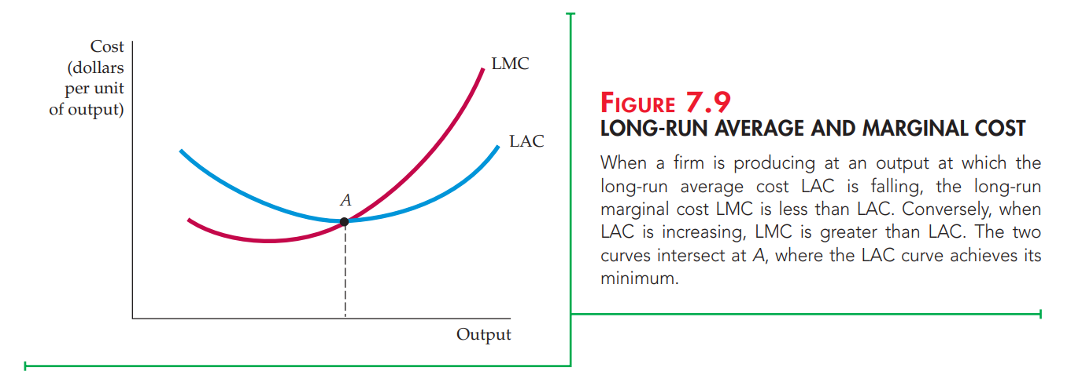

Slide 22
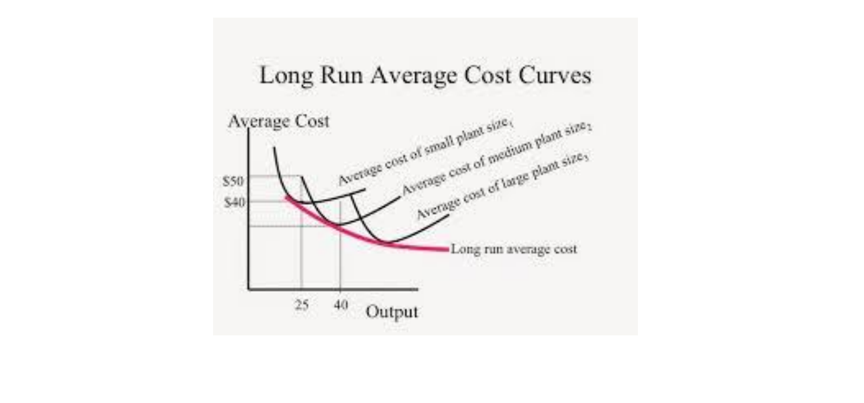
Long-run Versus Short-run Cost Curves
Long-Run Average Cost

Slide 23
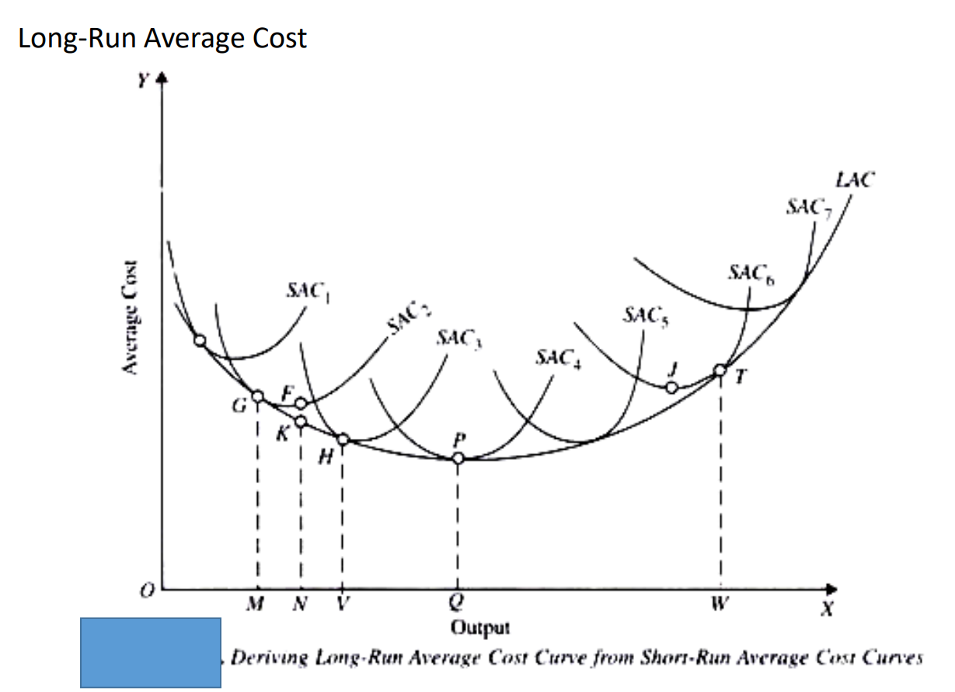
Long-Run Average Cost

Slide 24
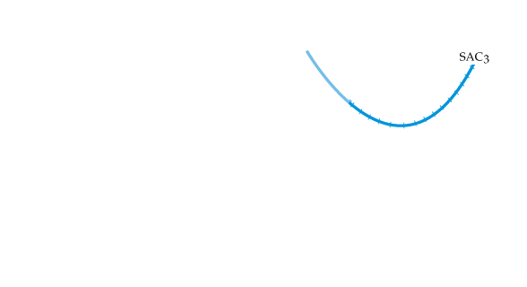
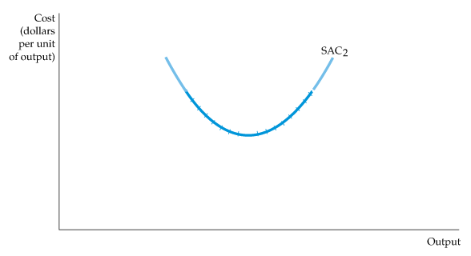
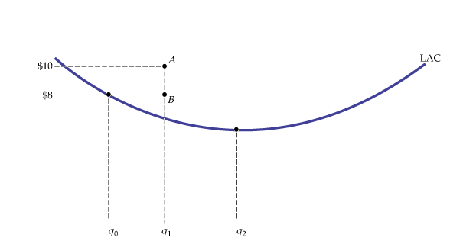
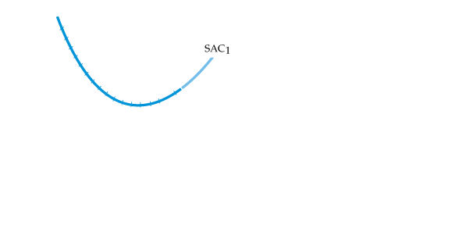
LONG-RUN VERSUS SHORT-RUN COST CURVES
The Relationship Between Short-Run and Long-Run Cost
Figure 7.9
Long-Run Cost with Economies and Diseconomies of Scale
The long-run average cost curve LAC is the envelope of the short-run average cost curves SAC₁, SAC₂, and SAC₃.
With economies and diseconomies of scale, the minimum points of the short- run average cost curves do not lie on the long-run average cost curve.

Slide 25
Long-run Average Cost Curve (LAC) - Curve relating average cost of production to output when all inputs, including capital, are variable.
Short-run Average Cost Curve (SAC) - Curve relating average cost of production to output when level of capital is fixed.
Long-run Marginal Cost Curve (LMC) - Curve showing the change in long-run total cost as output is increased incrementally by 1 unit.

Slide 26
The Structure of Costs in the Long Run
Generally speaking, the long run is the period of time when all costs are variable. It is not a precise period of time because it depends on the specifics of each firm.
If you have a one-year lease on your factory, then the long run is any period longer than a year since after a year, you are no longer bound by the lease.
No costs are fixed in the long run. A firm can build new factories and purchase new machinery, or it can close existing facilities. In planning for the long run, a firm can compare alternative production technologies or processes.
In this context, technology refers to all alternative methods of combining inputs to produce outputs. It does not refer to a specific new invention like the tablet computer.
Firms search for the production technology that will allow them to produce the desired level of output at the lowest cost. After all, lower costs lead to higher profits—at least if total revenues remain unchanged. In addition, each firm knows that if it does not seek out the lowest-cost methods of production, it may lose sales to competitor firms that find a way to produce and sell for less.

Slide 27
Choice of production technology in the Long Run
Many tasks can be performed with a range of combinations of labor and physical capital.
For example,
A firm can have human beings answering phones and taking messages, or it can invest in an automated voicemail system.
A firm can hire file clerks and secretaries to manage a system of paper folders and file cabinets, or it can invest in a computerized record-keeping system that will require fewer employees.
A firm can hire workers to push supplies around a factory on rolling carts, it can invest in motorized vehicles, or it can invest in robots that carry materials without a driver.
Firms often face a choice between buying many small machines, which need a worker to run each one, or buying one larger and more expensive machine, which requires only one or two workers to operate it.
In short, physical capital and labor can often substitute for each other.

Slide 28
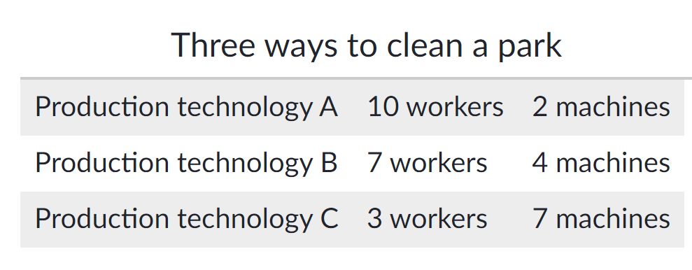
Let's look at an example—a private firm that is hired by local governments to clean up public parks.
In the table below, there are three different possible combinations of labor and physical capital for cleaning up a single average-sized park.
The first production technology is heavy on workers and light on machines; the next two technologies substitute machines for workers. Since all three of these production methods produce the same thing—one cleaned-up park—a profit-seeking firm will choose the production technology that is least expensive, given the prices of labor and machines.

Slide 29
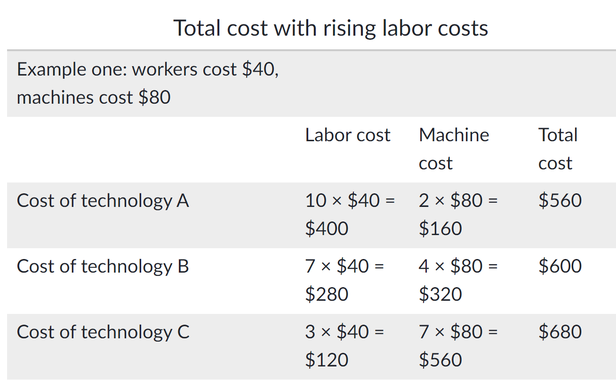
Production technology A uses the most labor and least machinery. Production technology C uses the least labor and the most machinery.
The table below outlines three examples of how the total cost changes with each production technology as the cost of labor changes. Why do you think that as the cost of labor rises from example one to two to three, the firm will choose to substitute away from labor and use more machinery?

Slide 30
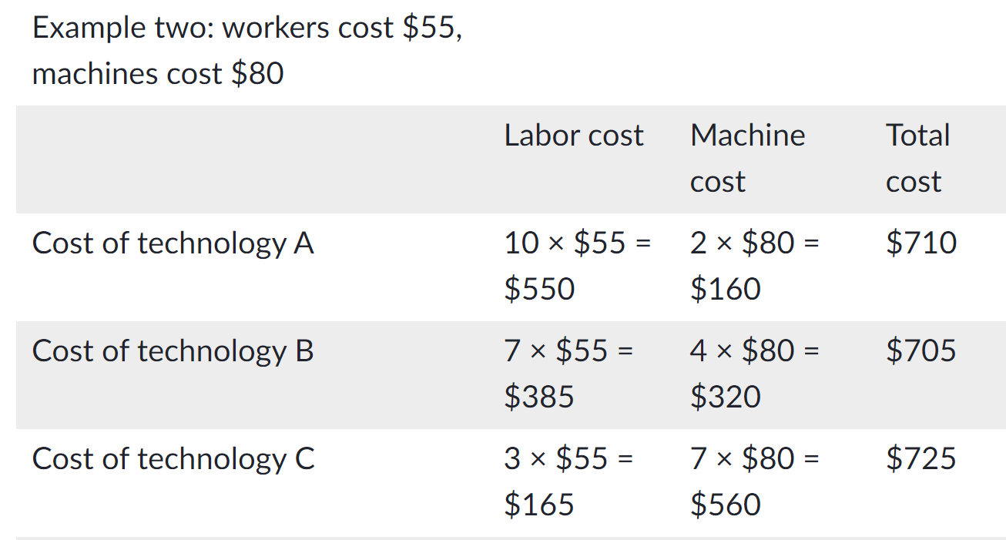
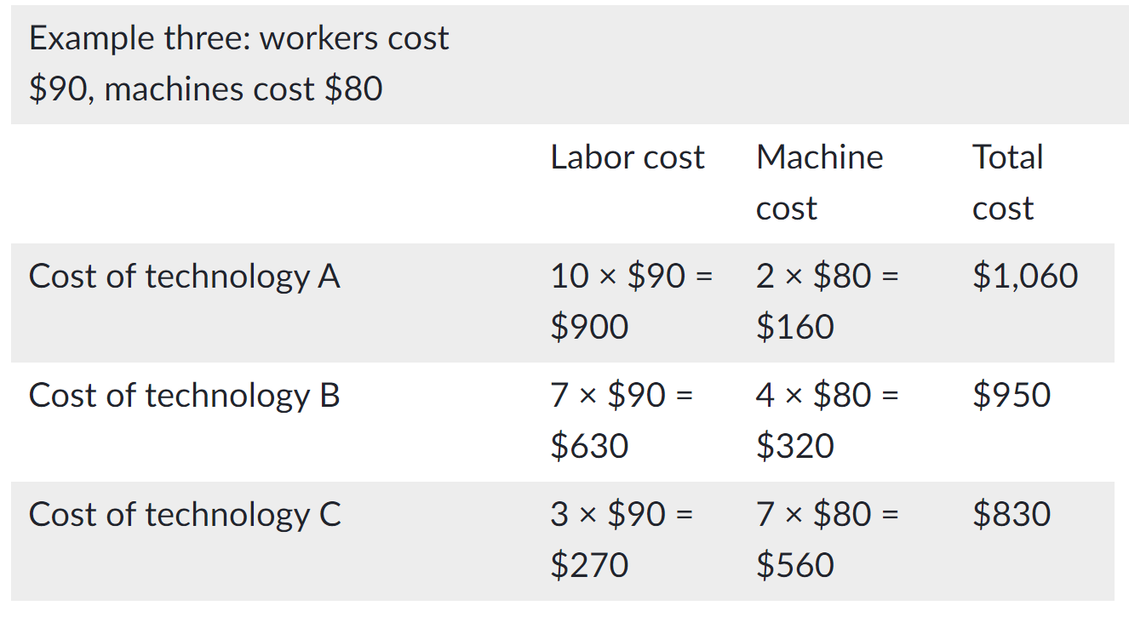

Slide 31
Example one shows the firm’s cost calculation when wages are $40 and machine costs are $80. In this case, technology A is the lowest-cost production technology. In example two, wages rise to $55, while the cost of machines does not change. In this case, technology B is the lowest-cost production technology. If wages keep rising up to $90—while the cost of machines remains unchanged—then technology C becomes the lowest-cost form of production, as shown in example three.
These examples show that as an input becomes more expensive—for example, the wage of labor has increased—firms will attempt to conserve on using that input and will instead shift to other inputs that are relatively less expensive.
This pattern helps to explain why the demand curve for labor, or any input, slopes down; as labor becomes relatively more expensive, profit-seeking firms will seek to substitute the use of other inputs.
For example: When a multinational employer like Coca-Cola or McDonald’s sets up bottling plants or restaurants in high-wage economies like the United States, Canada, Japan, or Western Europe, it is likely to use production technologies that conserve on the number of workers and focus more on machines.
However, that same employer is likely to use production technologies with more workers and less machinery when producing in lower-wage countries like Mexico, China, or South Africa.

Slide 32
Economies of Scale
Once a firm has determined the least costly production technology, it can consider the optimal scale of production, or quantity of output, to produce.
Many industries experience economies of scale—as the quantity of output goes up, the cost per unit goes down.
This is the idea behind so-called warehouse stores like Costco or Walmart.
In everyday language—a larger factory can produce at a lower average cost than a smaller factory.

Slide 33
The diagram below illustrates the idea of economies of scale; it shows the average cost of producing an alarm clock falling as the quantity of output rises.
For a small-sized factory like S—with an output level of 1,000—the average cost of production is $12 per alarm clock.
For a medium-sized factory like M—with an output level of 2,000—the average cost of production falls to $8 per alarm clock.
For a large factory like L—with an output of 5,000—the average cost of production declines still further to $4 per alarm clock.
The economies of scale curve is a long-run average cost, or LRAC, curve; it allows all factors of production to change.
Short-run average cost curves assume the existence of fixed costs, and only variable costs are allowed to change.

Slide 34
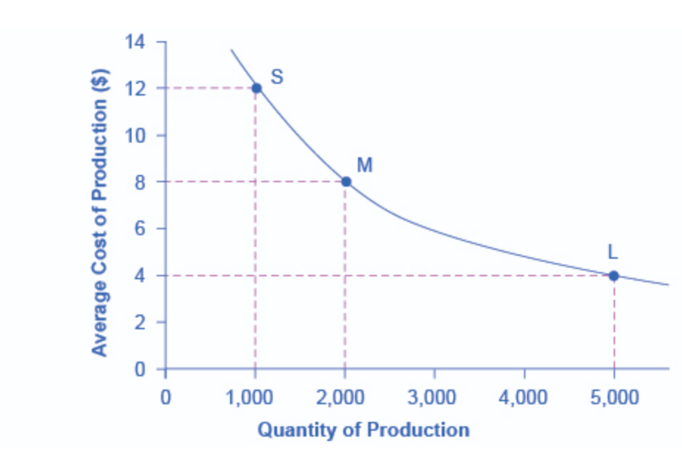

Slide 35
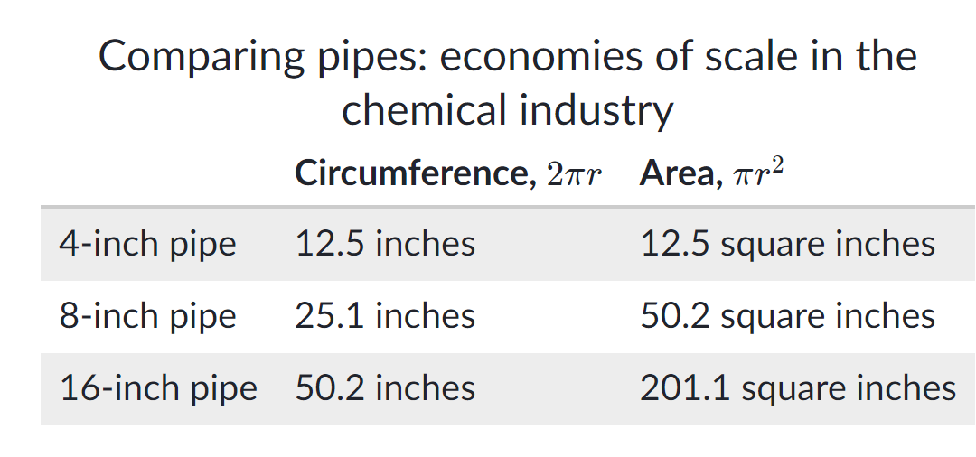
An example of economies of scale is the chemical industry. Chemical plants have a lot of pipes. The cost of the materials for producing a pipe is related to the circumference of the pipe and its length. However, the volume of chemicals that can flow through a pipe is determined by the cross-section area of the pipe.
The table below shows that a pipe which uses twice as much material to make—as shown by the circumference of the pipe doubling—can actually carry four times the volume of chemicals because the cross-section area of the pipe rises by a factor of four—as you can see in the area column.

Slide 36
A doubling of the cost of producing the pipe allows the chemical firm to process four times as much material. This pattern is a major reason for economies of scale in chemical production, which uses a large quantity of pipes.
Of course, economies of scale in a chemical plant are more complex than this simple calculation suggests, but the chemical engineers who design these plants have long used what they call the six-tenths rule—a rule of thumb which holds that increasing the quantity produced in a chemical plant by a certain percentage will increase total cost by only six-tenths as much.

Slide 37
Economies of Scale
As output increases, the firm’s average cost of producing that output is likely to decline, at least to a point.
This can happen for the following reasons:
If the firm operates on a larger scale, workers can specialize in the activities at which they are most productive.
Scale can provide flexibility. By varying the combination of inputs utilized to produce the firm’s output, managers can organize the production process more effectively.
The firm may be able to acquire some production inputs at lower cost because it is buying them in large quantities and can therefore negotiate better prices. The mix of inputs might change with the scale of the firm’s operation if managers take advantage of lower-cost inputs.

Slide 38
Diseconomies of Scale
At some point, however, it is likely that the average cost of production will begin to increase with output.
There are three reasons for this shift:
At least in the short run, factory space and machinery may make it more difficult for workers to do their jobs effectively.
Managing a larger firm may become more complex and inefficient as the number of tasks increases.
The advantages of buying in bulk may have disappeared once certain quantities are reached. At some point, available supplies of key inputs may be limited, pushing their costs up.

Slide 39
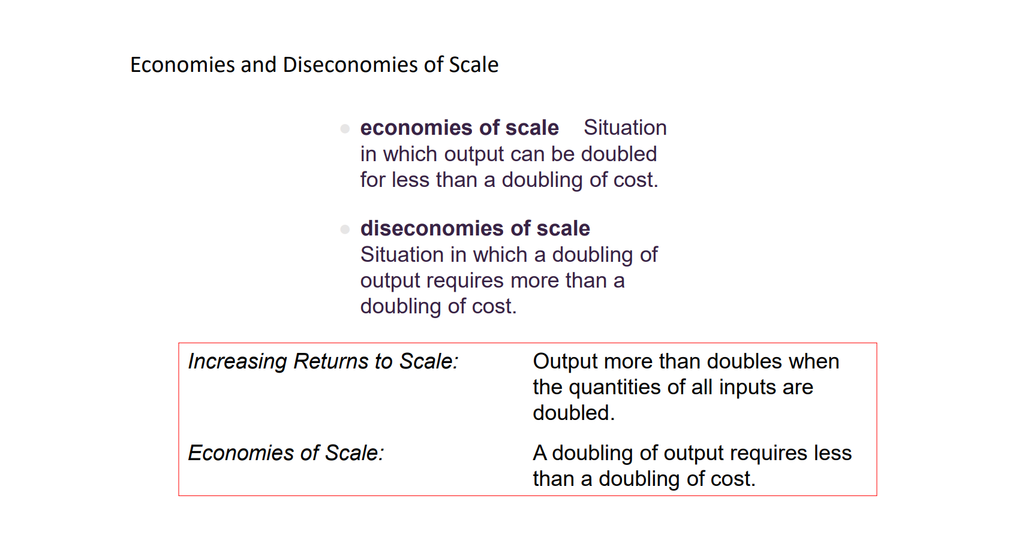

Slide 40
Economies and Diseconomies of Scope
Economies of Scope - Situation in which joint output of a single firm is greater than output that could be achieved by two different firms when each produces a single product.
Diseconomies of Scope - Situation in which joint output of a single firm is less than could be achieved by separate firms when each produces a single product.

Slide 41
Shifting patterns of Long-Run Average Cost
New developments in production technology can shift the LRAC curve in ways that alter the size distribution of firms in an industry.
For much of the 20th century, the most common change has been to see alterations in technology—like the assembly line or the large department store—where large-scale producers seemed to gain an advantage over smaller ones. These innovations caused the downward-sloping economies of scale portion of the LRAC curve to stretch over a larger quantity of output.
However, new production technologies do not inevitably lead to a greater average size for firms. For example, in recent years some new technologies for generating electricity on a smaller scale have appeared. Traditional coal-burning electricity plants needed to produce 300 to 600 megawatts of power to exploit economies of scale fully, but high-efficiency turbines used to produce electricity from burning natural gas can produce electricity at a competitive price while producing a smaller quantity of 100 megawatts or less. This new technology created the possibility for smaller companies or plants to generate electricity as efficiently as large ones.

Slide 42
Another example of a technology-driven shift to smaller plants may be taking place in the tire industry. A traditional mid-size tire plant produces about six million tires per year. However, in 2000, the Italian company Pirelli introduced a new tire factory that uses many robots. The Pirelli tire plant produced only about one million tires per year, but it does so at a lower average cost than a traditional mid-sized tire plant.
Controversy has simmered in recent years over whether new information and communications technologies will increase or decrease the size of firms. On one hand, the new technology may make it easier for small firms to reach out beyond their local geographic area and find customers across a state, the nation, or even across international boundaries. This factor might seem to predict a future with a larger number of small competitors.
On the other hand, new information and communications technology might create winner-take-all markets where one large company will tend to command a large share of total sales—as Microsoft has done in the production of software for personal computers or Amazon has done in online bookselling. Additionally, improved information and communication technologies might make it easier to manage many different plants and operations across the country or around the world, which could encourage larger firms.
How developing technologies affect firm size is of great interest to economists, businesspeople, and policymakers.

Slide 43
Sample Question
A profit maximizing firm produces output Q using two inputs L and K. The firm purchases L (labour) and K (capital) in competitive markets at price w = 20 and r = 10 per unit respectively and sells Q in a competitive market at some price p.
Calculate the long run cost of the firm as a function of the quantity of output for the following cases:
The production function of the firm is a Cobb- Douglas function, given by: Q =L^{2/3}K^{1/3}.
The inputs are perfect complements by nature and the production function is given by: Q =min (K, L).

